Slide 1


Dr. Zhiping Zheng
Chair Professor
Chair, Department of Chemistry
Executive Director, Shenzhen Grubbs Institute
Peking University (BS, 1987; MS,1990)
University of California, Los Angeles (PhD, 1995)
Postdoctoral Fellow, Harvard University (1995-1997)
Fellow, Royal Society of Chemistry (2016)
University of Arizona (1997-2017)

Slide 2
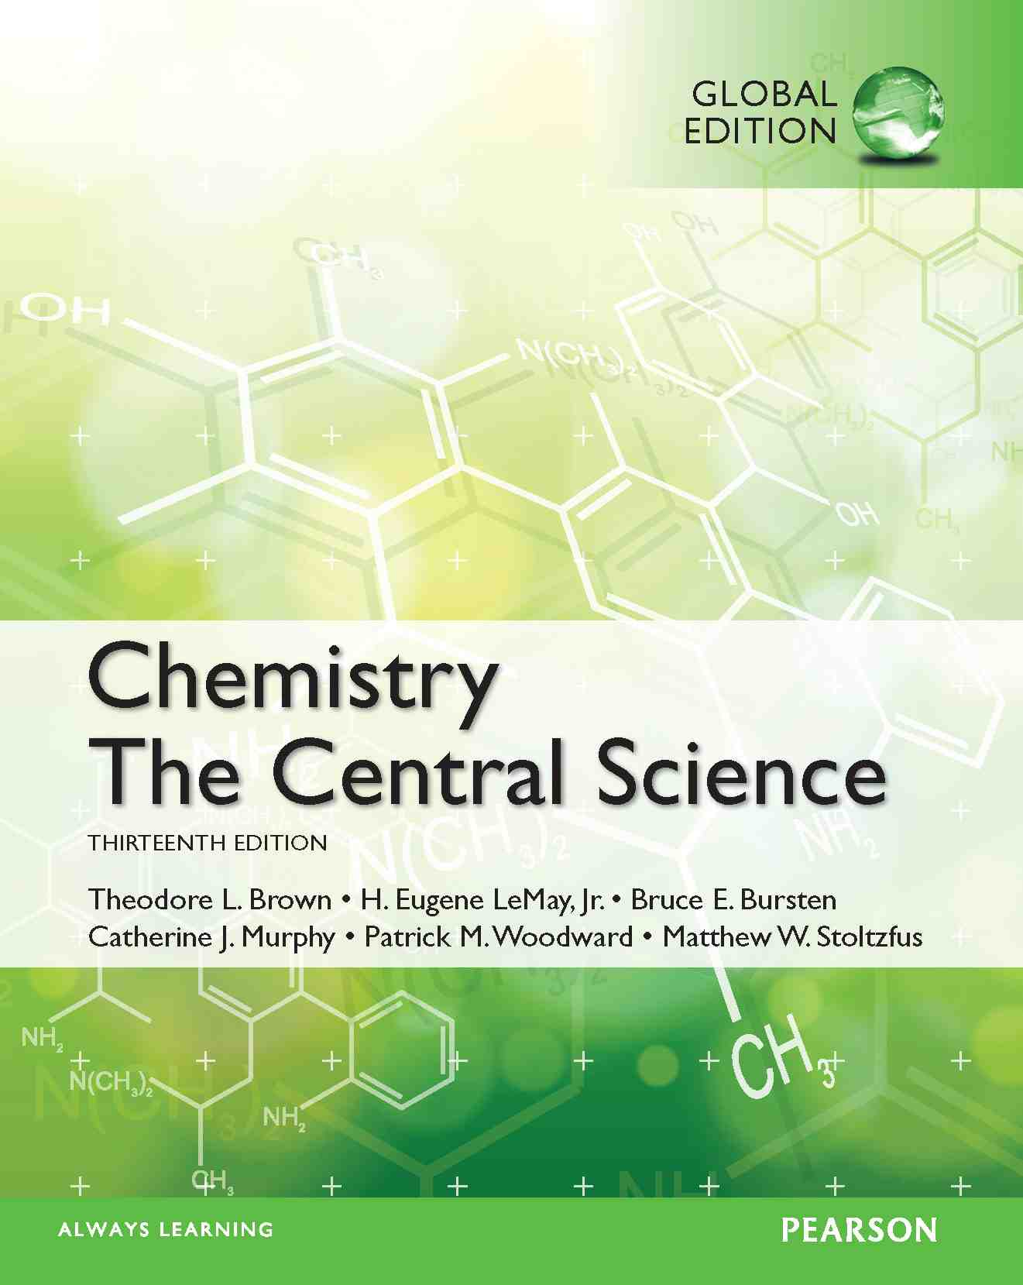
Chapter 3 Chemical Reactions and Reaction Stoichiometry
Lecture Presentation
James F. Kirby
Quinnipiac University
Hamden, CT

Slide 3
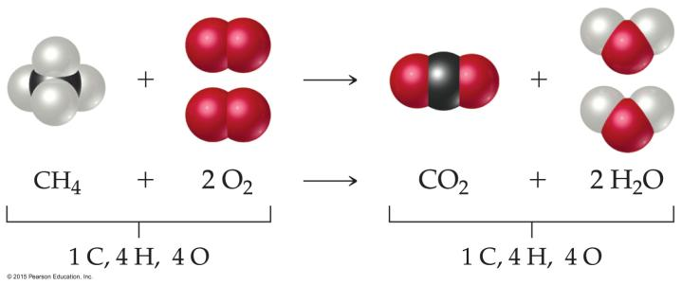
What Is in a Chemical Equation?
CH₄(g) + 2O₂(g) CO₂(g) + 2H₂O(g)
The states of the reactants and products are written in parentheses to the right of each compound.
(g) = gas; (l) = liquid; (s) = solid;
(aq) = in aqueous solution
co-efficient
to balance

Slide 4
Three Types of Reactions
Combination reactions
Decomposition reactions
Combustion reactions
Other types of reactions

Slide 5
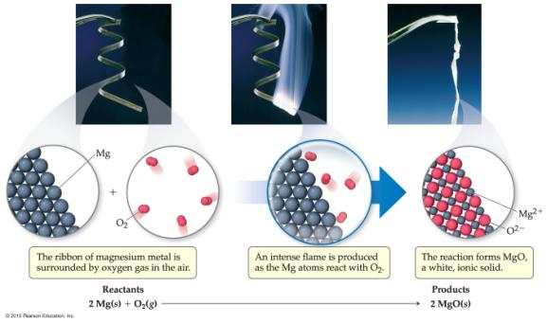
Combination Reactions
In combination reactions two or more substances react to form one product.
Examples:
2 Mg(s) + O₂(g) 2 MgO(s)
N₂(g) + 3 H₂(g) 2 NH₃(g)
C₃H₆(g) + Br₂(l) C₃H₆Br₂(l)

Slide 6
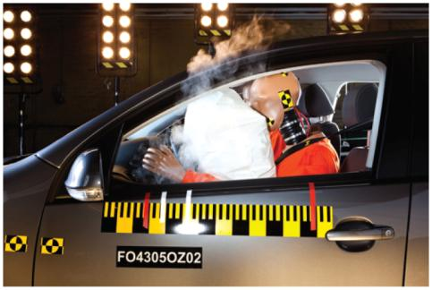
Decomposition Reactions
In a decomposition reaction one substance breaks down into two or more substances.
Examples:
CaCO₃(s) CaO(s) + CO₂(g)
2 KClO₃(s) 2 KCl(s) + O₂(g)
2 NaN₃(s) 2 Na(s) + 3 N₂(g)

Slide 7
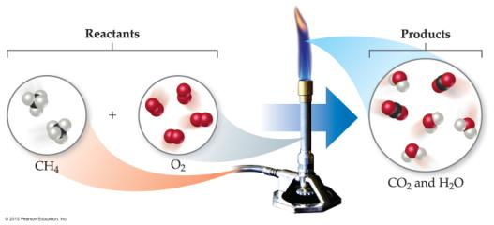
Combustion (to burn) Reactions
Combustion reactions are generally rapid reactions that produce a flame.
Combustion reactions most often involve oxygen in the air as a reactant.
Examples:
CH₄(g) + 2 O₂(g) CO₂(g) + 2 H₂O(g)
C₃H₈(g) + 5 O₂(g) 3 CO₂(g) + 4 H₂O(g)

Slide 8
Quantities (the amount) reactants consumed products produced
Atoms or molecules are small and light!
Particles (atoms or molecules) ↔ Total mass
Total mass/mass of each particle = # of particles
And the # of particles is HUGE!

Slide 9
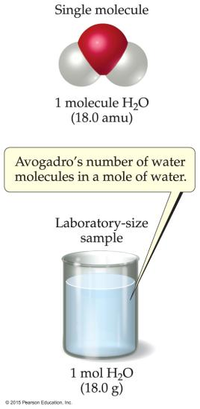
Avogadro’s Number
One dozen = 12
One mole = 6.02 × 10²³
In a lab, we cannot work with individual molecules. They are too small.
6.02 × 10²³ atoms or molecules is an amount that brings us to lab size. It is ONE MOLE.
One mole of ¹²C has a mass of 12.000 g.

Slide 10
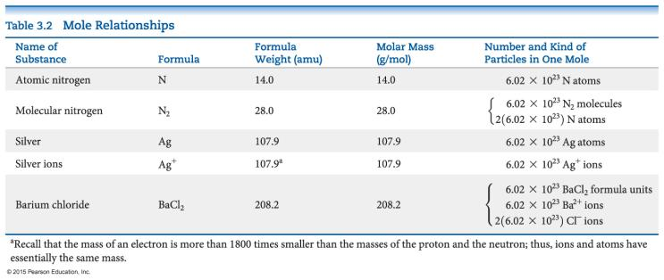
Mole Relationships

Slide 11
Percent Composition
One can find the percentage of the mass of a compound that comes from each of the elements in the compound by using this equation:
(number of atoms)(atomic weight)
% Element =
× 100
(FW of the compound)

Slide 12
Percent Composition
The percentage of carbon in ethane （C₂H₆） is
(2)(12.011 amu)
%C =
(30.070 amu)
24.022 amu
=
× 100%
30.070 amu
= 79.887%

Slide 13
Determining Empirical Formulas
A compound is composed of carbon (61.31%), hydrogen (5.14%), nitrogen (10.21%), and oxygen (23.33%). Find its empirical formula.
Assuming 100.00 g of this compound,
C: 61.31 g × = 5.105 mol C
H: 5.14 g × = 5.09 mol H
N: 10.21 g × = 0.7288 mol N
O: 23.33 g × = 1.456 mol O
1 mol
12.01 g
1 mol
1.01 g
1 mol
14.01 g
1 mol
1 mol
16.00 g

Slide 14
Determining Empirical Formulas
Calculate the mole ratio by dividing by the smallest number of moles:
5.105 mol
0.7288 mol
C: = 7.005 ≈ 7
H: = 6.984 ≈ 7
N: = 1.000 → 1
O: = 2.001 ≈ 2
5.09 mol
0.7288 mol
E.F. C₇H₇NO₂
0.7288 mol
0.7288 mol
1.458 mol
0.7288 mol

Slide 15
Determining a Molecular Formula
(empirical formula) x n = molecular formula
empirical formula weight
(real) formula weight
or molar mass
The empirical formula of a compound was found to be CH. (13 g/mol)
It has a molar mass of 78 g/mol.
What is its molecular formula? (78/13 = 6 =n) M.F. = 6(EF) = 6(CH) = C₆H₆.

Slide 16
Stoichiometric (molar ratio) Calculation
How many grams of water can be produced from 1.00 g of glucose?
C₆H₁₂O₆(s) + 6 O₂(g) → 6 CO₂(g) + 6 H₂O(l)
1 mole of glucose will produce 6 moles of water.
There is 1.00 g of glucose to start.
The first step is to convert mass (g) it to moles.

Slide 17
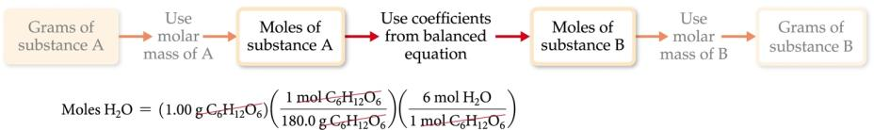
Stoichiometric (molar ratio) Calculation
C₆H₁₂O₆(s) + 6 O₂(g) → 6 CO₂(g) + 6 H₂O(l)
1
6
#mole of glucose
#moles of water
1.00 g/180.0 g/mol
X g/18.0 g/mol
Glucose
Water
=
=
=

Slide 18
Limiting Reactants (Reagents)
C₆H₁₂O₆(s) + 6 O₂(g) → 6 CO₂(g) + 6 H₂O(l)
1 mole 6 moles (molar ratio)
2 moles 12 moles (perfect!)
2 moles (deficient/limiting) 15 moles (12 + 3 moles of O₂ in excess)
2 moles (excess) 11 moles (12 - 1) --- O₂ (deficient/limiting)
The limiting reactant runs out (is consumed) first.
!!! The amount of a product produced is dependent on the limiting reactant.

Slide 19
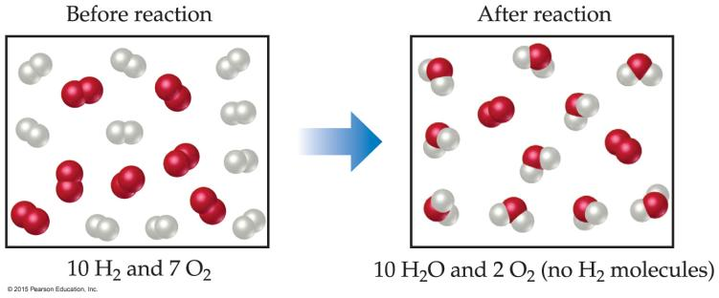
Limiting Reactants
2 H₂ + O₂ → 2 H₂O
14 H₂ molecules are needed for 7 O₂ molecules.
H₂ is thus limiting and runs out first.
O₂ is in excess with a certain amount unreacted.

Slide 20
Percent Yield
One finds the percent yield by dividing the amount actually obtained (actual or real yield) to the amount it was possible to make (theoretical or perfect yield):
(from experiment)
actual yield
theoretical yield
Percent yield = × 100
(from calculation – a prefect reaction)

Slide 21
C₆H₁₂O₆(s) + 6 O₂(g) → 6 CO₂(g) + 6 H₂O(l)
1.00 g of glucose reacts with an excess amount of O₂ afforded 0.42 g water.
1
6
#mole of glucose
#moles of water
1.00/180.0
x/18.0
Glucose
Water
=
=
=
Theoretical yield? (0.60 g)
Actual yield? (0.42 g)
Percentage yield? (0.42/0.60 = 70%)
The exact amount of O₂ to react with 1.00 g of glucose? (1.07 g)
How many grams of CO₂ may be perfectly produced by reacting
1.00 g of glucose with 0.27 g of O₂? (limiting reactant?)
How many grams of glucose are left unreacted?

